Slide 1





Customer Churn Analysis
Predicting Customer Retention & Reducing Revenue Risk Using Data Analytics
Dataset: IBM Telco Customer Churn (Kaggle)
Presented by Dileep Thiriveedhi

Slide 2
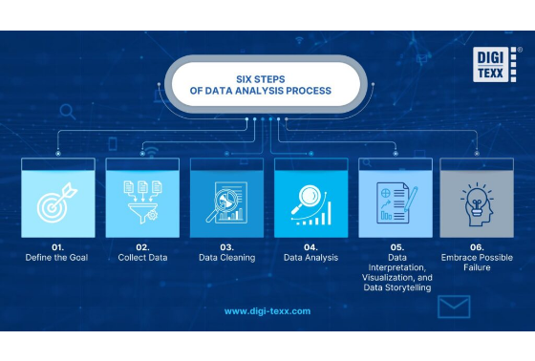
Dataset Overview
The dataset originates from IBM Sample Data Sets and contains demographic, subscription, billing, and retention details for telecom customers.
Metric | Value / Detail
Total Customers | 7,043 Records
Features | 21 Variables
Target Variable | Churn
Churn Classes | Yes / No

Slide 3


Business Problem & Objectives
The Problem
Key Objectives
Customer churn directly reduces recurring revenue and hinders long-term business growth.
• Identify customers with high risk of churn.
• Discover key drivers influencing cancellation.
Acquiring a new customer costs 5x to 7x more than retaining an existing customer in telecom markets.
• Analyze customer behavioral trends.
• Recommend proactive retention strategies.

Slide 4




End-to-End Analytics Workflow
4. Dashboard & Actions
2. Data Preparation
Cleaning missing values, type conversion, and feature engineering tenure groups.
Building interactive Power BI dashboard & distilling strategic retention insights.
1. Pipeline Setup
3. Analysis & SQL
Business problem formulation, Kaggle data ingestion & Pandas ETL pipeline setup.
Exploratory data analysis (EDA) and querying customer segments with SQL.

Slide 5






Technology Stack
Python
SQL & Excel
Power BI
Pandas & NumPy used for data cleaning, type conversion, missing value handling, and ETL execution.
Querying business metrics, executing aggregations, pivot table validation, and segment analysis.
Building executive DAX measures, interactive filters, KPI visual cards, and retention dashboards.

Slide 6


Data Cleaning & Feature Engineering
ETL & Data Cleaning
Feature Engineering
✔ Imported 7,043 raw customer records using Pandas
• Tenure Groups: Created cohorts (1M, 2M, 3M, 47+M) to isolate early churn risk.
✔ Converted TotalCharges from string object to float
✔ Removed 11 blank spaces / missing charge entries
• Revenue Metrics: Derived Average Monthly Spend per customer segment.
✔ Deduplicated records and standardized categories
• Segmentation: Grouped by payment method and senior citizen status.

Slide 7



Executive KPI Highlights
7,043
26.58%
5,174
$16.05M
Total Customers
Churn Rate (1,869)
Retained Customers
Total Revenue
Key Takeaway: Over 1 in 4 telecom customers discontinue service, highlighting an immediate opportunity to capture lost annual recurring revenue.

Slide 8
Demographics & Churn Breakdown
Gender Distribution
Senior Citizen Matrix
The dataset exhibits an almost equal split between male and female subscribers:
Senior Category | Male | Female
Non-Senior (No) | 2,981 | 2,920
Senior Citizen (Yes) | 574 | 568
Gender | Count | Share
Male | 3,555 | 50.48%
Female | 3,488 | 49.52%
Observation: Gender is balanced and is not a primary statistically significant driver for churn.

Slide 9
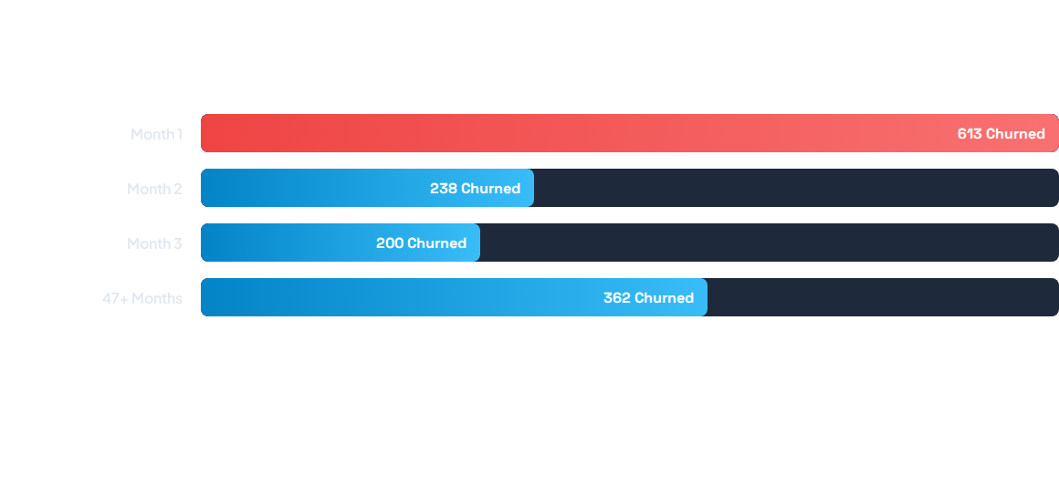
Customer Lifecycle & Churn Peak
Critical Insight: Over 60% of early cancellations occur within the first month. Customers who pass the initial 90-day threshold show significantly higher long-term retention.

Slide 10
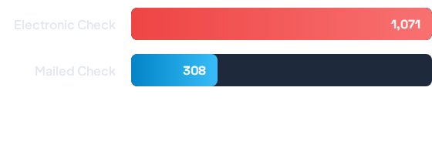

Payment Method Risk Profile
Risk Finding
Electronic Check customers account for the largest share of total churn (1,071 users).
This points toward potential pain points in manual payment processing, billing friction, or lack of auto-pay incentives.

Slide 11
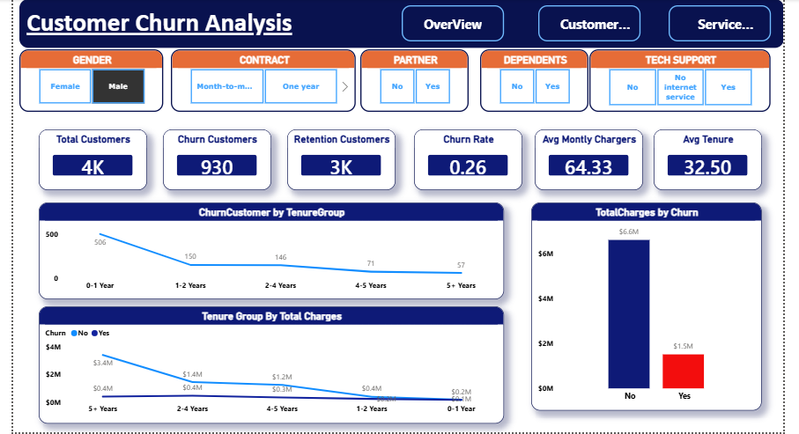
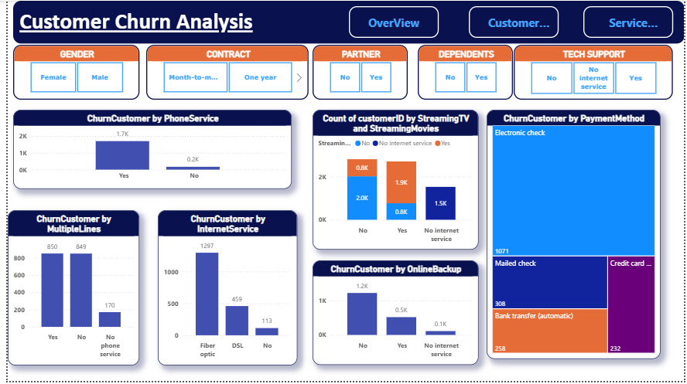
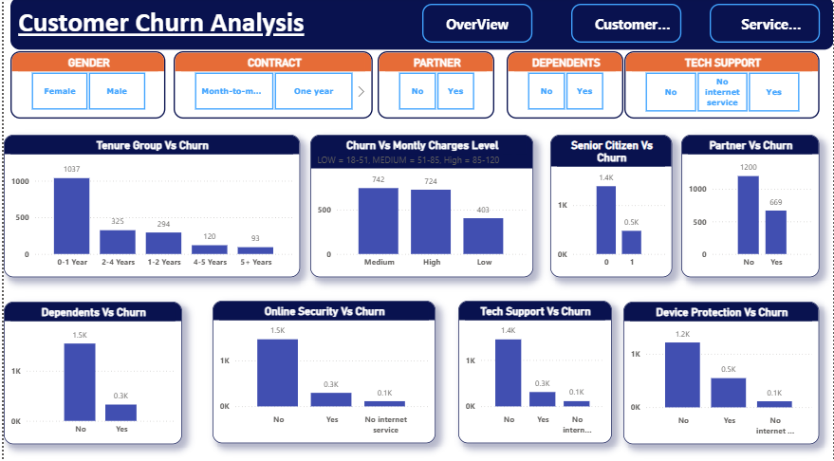
Interactive Power BI Dashboard
An interactive executive dashboard built in Power BI to monitor customer health metrics and retention trends in real time.
Executive KPI Cards: Instant visibility into ARR and churn rates.
Dynamic Slicers: Filter by contract type, tenure cohort, and payment method.
Customer Segmentation: Demographic drill-downs.

Slide 12




Core Business Insights
1. Early Retention Risk
2. High-Risk Payment Method
The highest churn concentration occurs within the customer's first 90 days of subscription.
Electronic Check users represent the most vulnerable customer segment for churn.
3. Demographic Neutrality
4. Onboarding Window
Gender distribution is balanced and does not impact churn, shifting focus to service factors.
Protecting customers during initial onboarding offers the highest ROI for retention efforts.

Slide 13
Strategic Action Plan
Enhance First 90-Day Onboarding: Deploy dedicated guidance and customer support touchpoints during the critical first three months.
Drive Auto-Pay Adoption: Offer small bill discounts or rewards for switching from Electronic Check to automated credit card / ACH payments.
Targeted Retention Campaigns: Focus promotional offers on new subscribers showing low initial feature usage.
Long-term Loyalty Programs: Reward customers reaching tenure milestones to safeguard lifetime value.
Predictive Analytics Integration: Deploy machine learning classification models to flag high-risk accounts prior to cancellation.

Slide 14


Summary & Impact
Key Achievements
Business Impact
• Engineered clean ETL pipeline from raw Kaggle dataset
• Enables data-driven proactive retention strategies
• Analyzed multi-variable demographic and service data
• Reduces early subscriber drop-off by targeting onboarding
• Developed executive KPIs and interactive Power BI report
• Mitigates revenue loss from high-risk payment segments
• Identified primary churn drivers across payment & tenure

Slide 15

Questions & Discussion
Thank you for your time and attention!
Dileep Thiriveedhi
LinkedIn
GitHub
Email

